Slide 1
THE ABANDONED HOUSE
BY TEMA

Slide 2
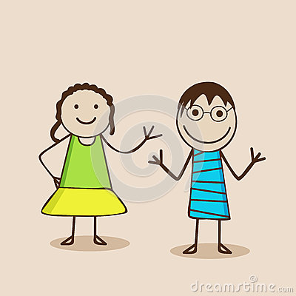
“Yes you can go for a stroll out side with George, but don't go to the abandoned house,” exclaimed mum, stomping down the stairs “we wont mum.” They said innocently as Laura grabbed Georges arm and winked at him.

Slide 3
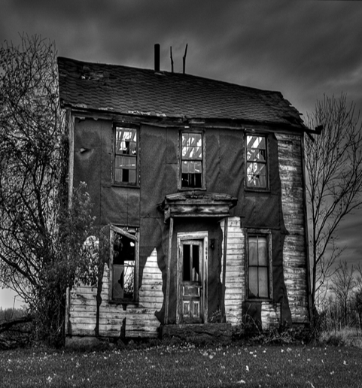
As the children finally reached the long lost house, Laura grabbed Georges arm and pulled him up the steps they both stood against the large door. As Laura opened the door, the boy shivered they went inside and the door suddenly closed. The twins followed a glowing purple light that they heard in school. George felt Goosebumps up his arm but he didn't say a word.

Slide 4
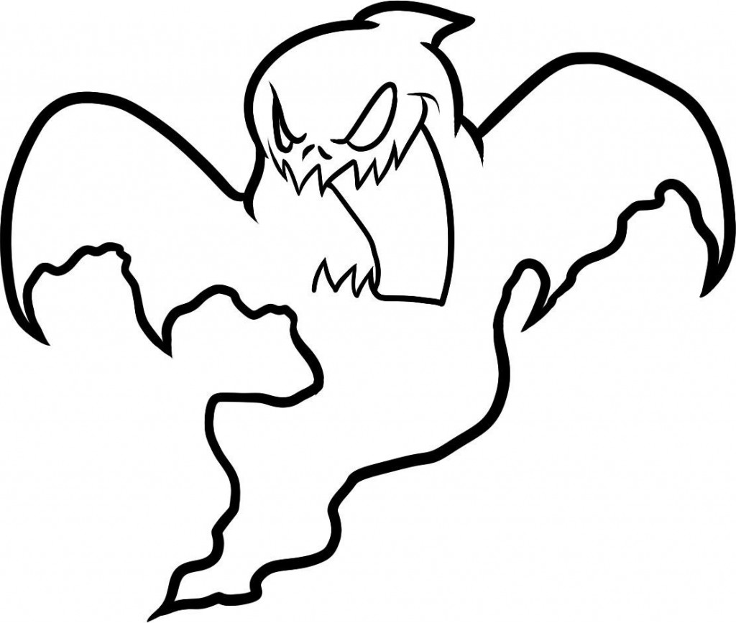
Unfortunately, there was a loud knock on the door the children's blood froze. Laura went backwards and retreated until the door flung open. There was no one there then there a mysterious figure came through the ceiling that they also was what they heard in school and if you open the large door a locked up ghost will escape and trap you in the old house that also have been told in school . George whinnied, “I think we should go home.” Laura replied, “I think you're right.” Suddenly, the door slammed shut, “I can’t open it,” Laura exclaimed. They were trapped they both went backwards and backwards but then George felt a shiver down his spine and stopped but Laura kept going and then she fell down a deep pit she struggled to get out but it was no use.

Slide 5
In a split second, an angle came down, she whispered to George, “you didn’t want to come here but you did, that is a sign of courage and now it’s your time to help someone in need. Now I will give you special powers. Please use them sensibly your powers will fade away after you’ve used them or they will not go and that only happens when you show love to other people.” Then a bolt of lightning hit him. He had never felt so strong he felt power full even more than he used to. Then he had muscles and didn’t look like wimp anymore- he didn’t even have to wear glasses any more.
Laura is lucky to have a friend like George.
ANYWAY he went near the pit and pulled Laura but she slipped out of his hand and then he got her with strong hand and pulled her out.

Slide 6
Laura told her mum (who is the president) all about it. Her mother was proud of George but disappointed with Laura because she warned her not to go there. Early one morning, she announced George a hero and gave him a real gold trophy everyone thought that this was a joke because everyone knows that he doesn't like super hero any way everyone felt safe because they have seen Georges super powers and seen how strong he actually is.

Slide 7
THE END.

